Slide 1


Analyzing the Impact of Car Features on Price and Profitability project - 7

Slide 2
Task 1 : How does the popularity of a car model vary across different market categories

Slide 3
Task 2 :What is the relationship between a car's engine power and its price

Slide 4
Task 3 :Which car features are most important in determining a car's price

Slide 5
Task 4 : How does the average price of a car vary across different manufacturers

Slide 6
Task 5 : What is the relationship between fuel efficiency and the number of cylinders in a car's engine

Slide 7
Dash 1: How does the distribution of car prices vary by brand and body style

Slide 8
Dash 2 : Which car brands have the highest and lowest average MSRPs, and how does this vary by body style

Slide 9
Dash 3 : How do the different feature such as transmission type affect the MSRP, and how does this vary by body style

Slide 10
Dash 4 : How does the fuel efficiency of cars vary across different body styles and model years

Slide 11
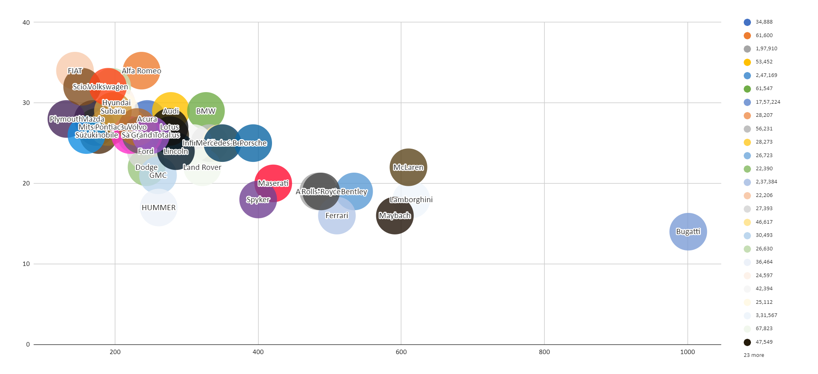
Dash 5 : How does the car's horsepower, MPG, and price vary across different Brands

Slide 12
Result and discussion
We utilized visualizations like pivot tables, scatter plots, and bar charts to effectively present the analysis results. These visual tools enable stakeholders to better understand the findings and support informed decision-making.
The insights derived from this analysis hold considerable significance for car manufacturers, offering valuable information about consumer preferences, pricing trends, and market dynamics. This knowledge can inform strategic decisions to improve profitability and competitiveness.
Looking ahead, further analysis could investigate dynamic pricing strategies, integrate real-time market data, and utilize advanced machine learning techniques for predictive modeling. Additionally, continuous monitoring of market trends and consumer preferences is crucial for maintaining competitiveness in the automotive industry. Overall, the insights from this analysis offer valuable guidance for car manufacturers aiming to refine their pricing and product development strategies in an ever-evolving market landscape.

